Slide 1
Lecture 05
CYBER SECURITY AND LAWS
By
Prof.Neha S.Sakhalkar

Slide 2
Chapter 2 : Cyber offenses and Cybercrime

Slide 3
Cyber offenses : How criminals plan attacks
Types of cyberattacks
How a criminal plans the attack
Social Engg
Role of cybercafes in Cybercrimes
Cyberstalking
Botnet and Attack Vector
Cloud Computing

Slide 4
Cybercrime : Mobile and Wireless Devices
Security challenges posed by mobile devices
Mitigation strategies
Understand organizational security implications
Various mobile devices

Slide 5
Cyber offenses : How criminals plan attacks
Types of cyberattacks
How a criminal plans the attack
Social Engg
Role of cybercafes in Cybercrimes
Cyberstalking
Botnet and Attack Vector
Cloud Computing

Slide 6
Types of Cyber attacks

Slide 7
Inside Attack:
An attack to the network or the computer system by some person with authorized system access is known as insider attack.
It is generally performed by dissatisfied or unhappy inside employees or contractors.
The motive of the insider attack could be revenge or greed.
The reason for insider attack is when a employee is fired or assigned new roles in an organization, and the role is not reflected in the IT policies
It is comparatively easy for an insider to perform a cyber attack as he is well aware of the policies, processes, IT architecture and the security system.
Moreover, the attacker have an access to the network.
The insider attack could be prevented by planning and installing an Internal intrusion detection systems (IDS) in the organization.

Slide 8
Outside Attack:
When the attacker is either hired by an insider or an external entity to the organization, it is known as external attack.
The organization which is a victim of cyber attack not only faces financial loss but also the loss of reputation.
An experienced network/security administrator keeps regular eye on the log generated by the firewalls as external attacks can be traced out by carefully analysing these firewall logs.
Also, Intrusion Detection Systems(IDS) are installed to keep an eye on external attacks.

Slide 9
What is a Firewall?
It is software that enforces a set of rules about which data packets will be allowed to enter or leave a network
Firewall Log Analysis gives info about
The security threat attempts at the periphery of the network
The nature of traffic coming in and going out of the firewall.
Information on the security threat attempts and so that they can swiftly initiate remediation action.

Slide 10
Structures Vs Non-structured Attacks :
Unstructured attacks:
Generally performed by amatures
No any predefined motives to perform the cyber attack.
Usually these amatures try to test a tool readily available
over the internet on the network of a random company

Slide 11
Structured Attack:
Performed by highly skilled and experienced people
Motive of attack is clear in mind.
Hackers have access to sophisticated tools and technologies
to gain access to other networks without being noticed by
their Intrusion Detection Systems(IDSs).
Attackers have the necessary expertise to develop or
modify the existing tools to satisfy their purpose.
Usually performed by professional criminals

Slide 12
Cyber crimes have turned out to be a low-investment, low-risk business with huge returns.
Now-a-days structured crimes which are performed are highly organized.
There is a perfect hierarchical organizational setup like formal organizations

Slide 13
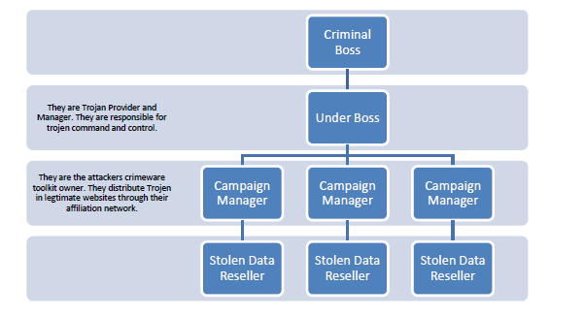
Hierarchical Organizational Structure

Slide 14
Active Vs Passive Attacks
Active Attack
Usually used to alter the system
Affect confidentiality,Integrity and Availability of the data
Passive Attack:
Used to gain information abut the target
Affects confidentiality of data

Slide 15
How Criminals plan the attacks?

Slide 16
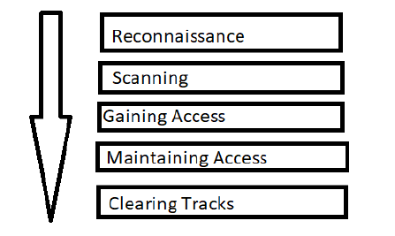
Phases involved in Planning the attack:
1.Reconnaissance
2.Scanning and scrutinizing
3.Launching an attack
Planning for an attack is a 5 step process :

Slide 17
1. Reconnaissance:
This is the first step of Hacking.
Also called as Footprinting
Phase where hacker collect as much information as possible about the target.
2.Scanning:
Three types of scanning are involved:
A)Port scanning
B)Vulnerability Scanning
C)Network Scanning

Slide 18
3. Gaining Access :
This phase is where an attacker breaks into the system/network
using various tools or methods.
4. Maintaining Access:
The aim is to maintain the access to the target until he finishes the tasks he planned to accomplish in that target.

Slide 19
5. Clearing Track:
No thief wants to get caught.
An intelligent hacker always clears all evidence so that in the later point of time, no one will find any traces leading to him.
This involves
- modifying/corrupting/deleting the values of Logs
- modifying registry values
- uninstalling all applications used
- deleting all folders created.

Slide 20
Phase – I: Reconnaissance

Slide 21
-borrowed from its military use
-explore with the goal of finding something to gain
information about enemy
-refers to a mission into enemy territory to obtain
information

Slide 22
Reconnaissance Involves
Accumulating data about target’s environment, computer architecture,vulnerabilities
Provides judgement about possible exploitation of found vulnerabilities
Provides details of system,its networking ports ad services
Above things are needed for launching an attack

Slide 23
Objectives of Reconnaissance
Collect Network Information
Collect System Information
Collect Organizations Information

Slide 24
Reconnaissance is done in TWO Phases :
Passive Attack
Active Attack

Slide 25
Passive Attack
Gathering information about a target without his/her(individual’s/company’s) knowledge
Usually involves
-searching information on web
-Network sniffing

Slide 26
Information search on Web is done in following ways:
Google or Yahoo search : employee information
Surfing community groups like orkut,Facebook : information of individual
Organizations’ website : information of key employees(contact details,e-mail IDs)
Blogs,newsgroups,press releases : media of information about company
Job postings of company of technical staff : provides information about type of technology,server specifications of the organization

Slide 27
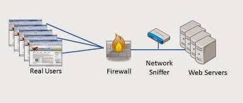
Network Sniffing
Network sniffing involves using sniffer tools that enable real-time monitoring and analysis of data packets in computer networks.
It can be a hardware device or a separate software program or a combination of both.
It takes copies of the packet data.

Slide 28
Network Sniffing is Used for ethical as well as unethical purposes.
Network administrators use these as network analyser tools to diagnose and prevent network-related problems such as traffic bottlenecks.
Cyber criminals use hacking tools to sniff, intercept, and steal private information such as user identities, passwords, login credentials, instant messages, data,and also for spoofing data.

Slide 29
Tools used for Passive Attack
Google Earth
Internet archive : Internet library including texts,audio,images,video,softwares
Professional Communities : LinkedIn
People Search : Personal details
WHOIS
Trace Route : Tool to find route taken by packet across IP network
Virtual Route Trace : how virtual traffic on computer network flows between source and target destination

Slide 30
Active Attack
Involves confirming the information gathered in passive reconnaissance(IP addresses,OS type and version,network services)
There is a risk of detection
Provides information about security measures of organization

Slide 31
Tools used in Active attack
Name of the Tool | Description
Arphound | Listens to traffic on network interface
Bugtraq | Database of known vulnerabilities and exploits
Dig | Extract configuration and administrative information about network or domain
Dsniff | Network auditing tool to capture username,password like authentication information on subnet
Filsnarf | Network auditing tool to capture file transfers and file shares onsubet
Hackbot | Host exploration tool ,vulnerability scanner
Hmap | Web server fingerprinting tool
Hping | Can do firewall testing,Advanced port scanning,remote OS fingerprinting,network testing
Nessus | Fast security scanner that tests for vulnerabilities
Nmap | Port scanner,OS fingerprinter, service/version identifier

Slide 32
Phase – II: Scanning and Scrutinizing Gathered Information

Slide 33
Scanning
Involves intelligently examining while the information is gathered
Types/Objectives of Scanning
Port scanning : Identify open/close ports and services
Network scanning : Understand IP addresses and related information about network systems
Vulnerability scanning : understand existing vulnerabilities in the system

Slide 34
Port Scanning
It is the technique used to identify open ports and services available on a network host
It is sometimes utilized by security technicians to audit computers for vulnerabilities, however, it is also used by hackers to target victims.
It can be used to send requests to connect to the targeted computers, and then keep track of the ports which appear to be opened, or those that respond to the request
Analogy with survey before burglary

Slide 35
Each individual computer runs on multiple ports.
TCP/IP protocol which is made out of two protocols TCP and UDP each of which has 0 to 65536 ports
For instance, when a person opens his or her email, the computer's server will open a port through which new mail will be downloaded through a connection to the email server.
Certain ports on an individual's personal computer are open continually, making them a target for any potential hacker who is searching for individuals to victimize.
Unfortunately, criminals and computer hackers are always looking for new victims to exploit and port scanning is one of the ways through which this can be accomplished.

Slide 36
Scrutinizing :
Done to identify
Valid user accounts or groups
Specifications of network resources
OS specifications and different applications running on OS
Usually most hackers spend 90% time in
Reconnaissance,Scanning and Gathering

Slide 37
Phase – III: Attack

Slide 38
Launching an Attack
Involves following steps
Crack the password
Exploit the privileges
Execute malicious commands
Hide the files
Cover the tracks by deleting logs

